Slide 1


Postgres & Social Sciences: How we make it work
Dr. Rémi Cura, Postdoctoral Associate
Prof. In Song Kim, Associate Professor
MIT Political Science Department
http://remi.cura.info
http://web.mit.edu/insong/www

Slide 2
Today
Social Sciences: Intro, challenges
Postgres strategies to help?

Slide 3


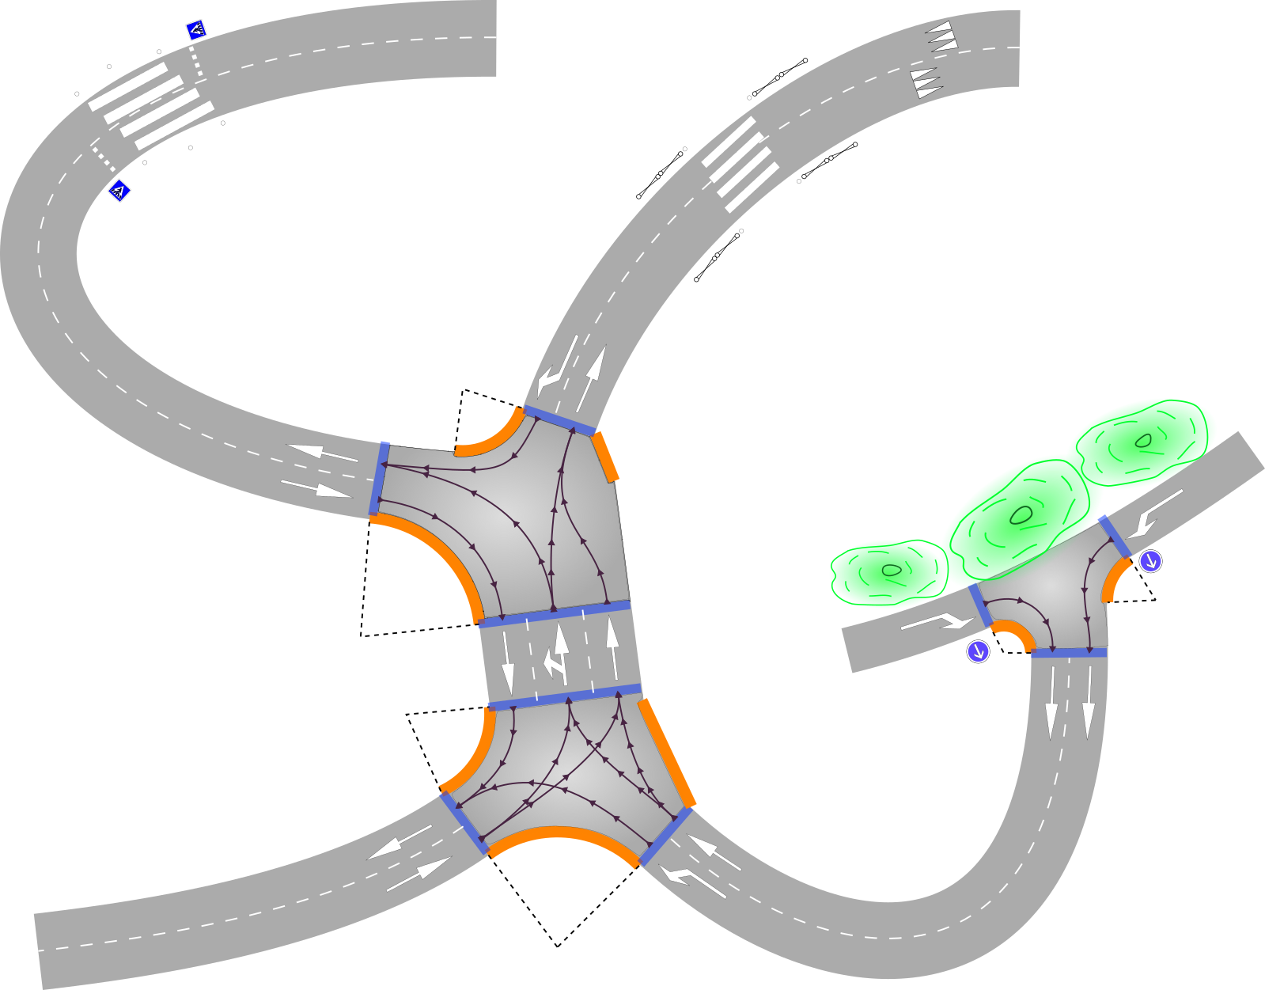
Previously:
Street model generation at city scale with Postgres
Urbanism: help design city for person with disabilities
Postgres + PostGIS + PgPointCloud

Slide 4


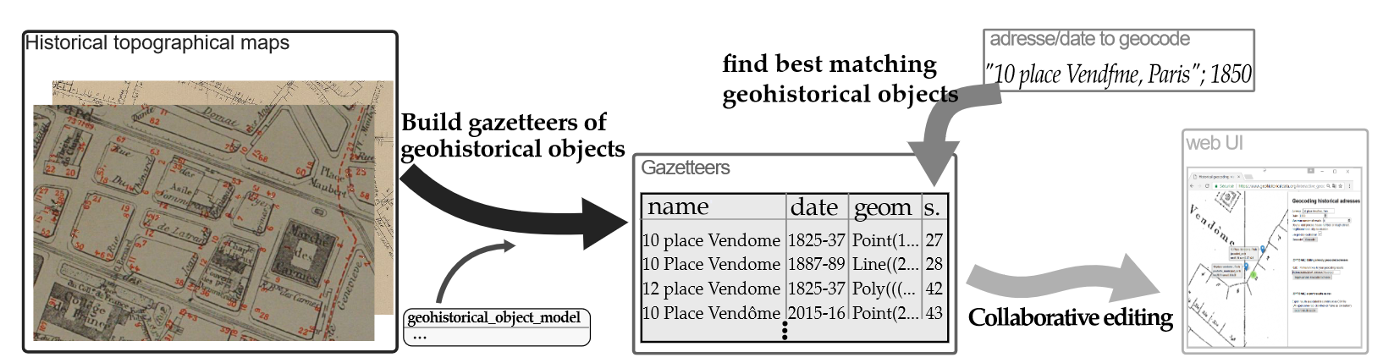
Previously
Paris historical map: 18th and 19th century, in Postgres
Where is (address; date)?
Social Dynamics in Urban Context

Slide 5

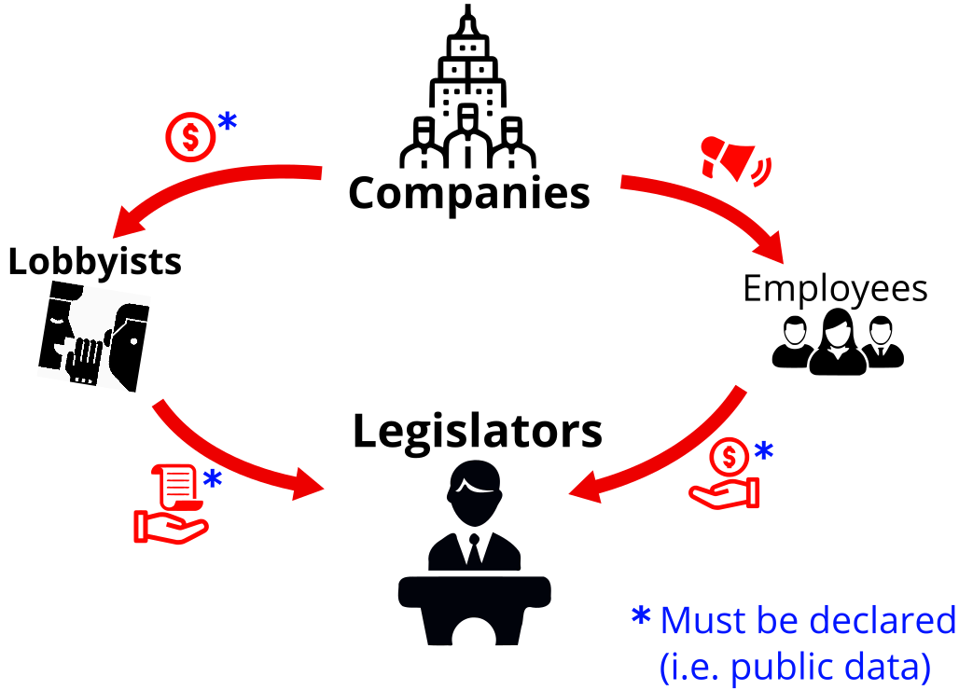
Lobbyview.org
Influence of money in US legislative life, with Postgres.
Political science

Slide 6
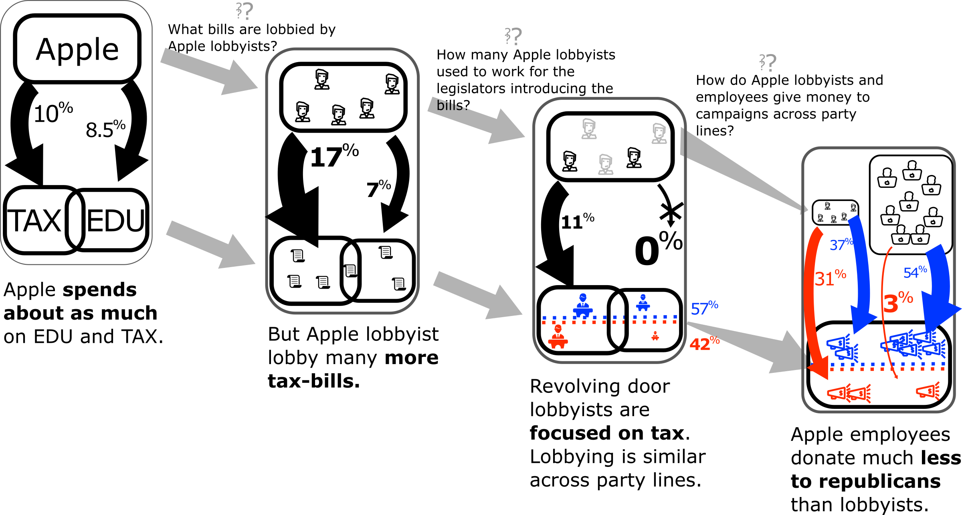
Example of research questions

Slide 7
Example of research questions

Slide 8
Example of research questions

Slide 9
Example of research questions

Slide 10
Goal
Create data and methods to investigate Social Sciences questions.
Typical approach in Social Sciences
one big .csv file
→ this is not going to work…

Slide 11
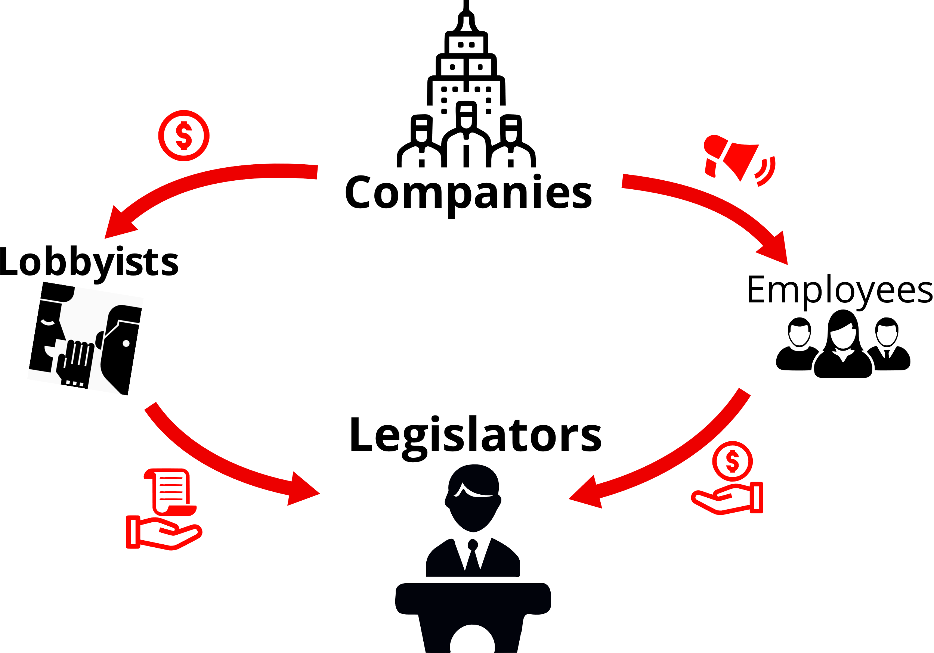
Challenges:
Data is fuzzy: About 10k$ during Q1 of 2014

Slide 12
Challenges:
Data is fuzzy: About 10k$ during Q1 of 2014
Data definition is ambiguous: Companies “influence” employees?

Slide 13
Challenges:
Data is fuzzy: About 10k$ during Q1 of 2014
Data definition is ambiguous: Companies “influence” employees?
Multiple conflicting data sources Money for “J. McCain”. Bills of “McCain, John S.” Is it the same guy?

Slide 14
Challenges:
Data is fuzzy: About 10k$ during Q1 of 2014
Data definition is ambiguous: Companies “influence” employees?
Multiple conflicting data sources Money for “J. McCain”. Bills of “McCain, John S.” Is it the same guy?
Specific Social Sciences needs: Explore, be Explainable

Slide 15
Challenges
Data is fuzzy “About 10k$”
Data definition is ambiguous “influence” on employees?
Conflicting data sources “J. McCain” VS “McCain, John S.”
Specific to Social Sciences: Explore, be Explainable
Postgres solutions?

Slide 16
Challenges
Postgres features
Data is fuzzy “About 10k$”
Data definition is ambiguous “influence” on employees?
Conflicting data sources “J. McCain” VS “McCain, John S.”
Specific to Social Science: Explore, be Explainable
Ranges
Fuzzy types

Slide 17
Challenges
Postgres features
Data is fuzzy “About 10k$”
Data definition is ambiguous “influence” on employees?
Conflicting data sources “J. McCain” VS “McCain, John S.”
Specific to Social Science: Explore, be Explainable
Ranges
Fuzzy types
Data modeling
FDW
ML + PlPython

Slide 18
Challenges
Postgres features
Data is fuzzy “About 10k$”
Data definition is ambiguous “influence” on employees?
Conflicting data sources “J. McCain” VS “McCain, John S.”
Specific to Social Science: Explore, be Explainable
Ranges
Fuzzy types
Data modeling
FDW
ML + PlPython
Inheritance
Full Text Search
N.L.P

Slide 19
Challenges
Postgres features
Data is fuzzy “About 10k$”
Data definition is ambiguous “influence” on employees?
Conflicting data sources “J. McCain” VS “McCain, John S.”
Specific to Social Science: Explore, be Explainable
Ranges
Fuzzy types
Data modeling
FDW
ML + PlPython
Inheritance
Full Text Search
N.L.P
FDW
GraphQL
Network analysis

Slide 20
Challenges
Postgres features
Data is fuzzy “About 10k$”
Data definition is ambiguous “influence” on employees?
Conflicting data sources “J. McCain” VS “McCain, John S.”
Specific to Social Science: Explore, be Explainable
How to solve these challenges with Postgres? What strategies?
Ranges
Fuzzy types
Data modeling
FDW
ML + PlPython
Inheritance
Full Text Search
N.L.P
FDW
GraphQL
Network analysis

Slide 21
Practical needs
Users =
Experts
Social Scientists
Students
Postgres experts
SQL experts
Developers
…
Design choices toward simplicity
Connecting to Postgres is already a challenge for users

Slide 22
Strategies:
Data is fuzzy “About 10k$”
Data definition is ambiguous “influence” on employees?
Conflicting data sources “J. McCain” VS “McCain, John S.”
Specific to Social Sciences: Explore, be Explainable
Strategy 1: Dealing with Fuzzy data

Slide 23
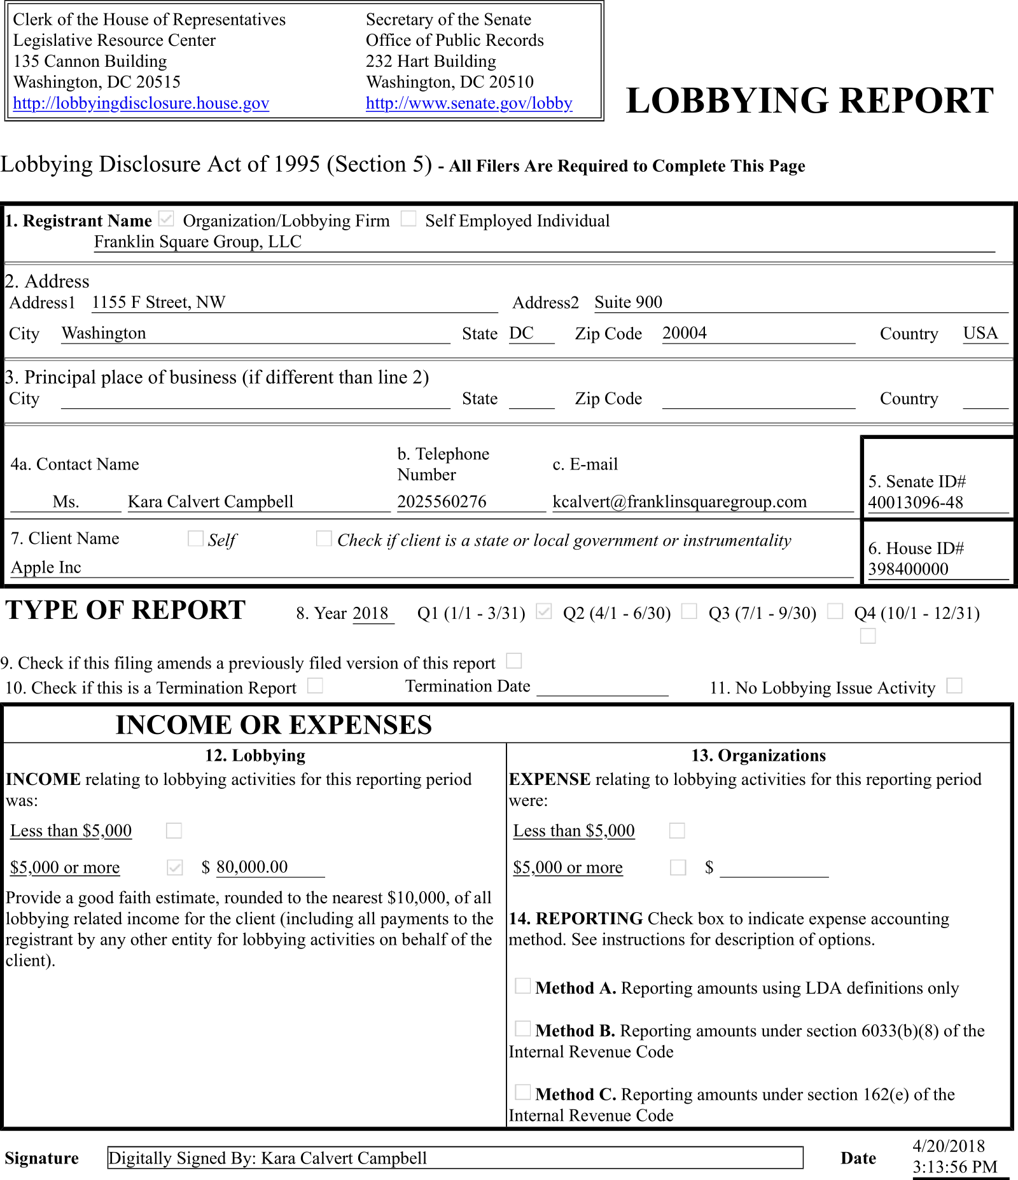
Fuzzy data?
Postgres range type:
Basic operators
Gist, SP-Gist indexes
SELECT daterange('2018-01-01', '2018-03-31');
-- [2018-01-01,2018-03-31)

Slide 24
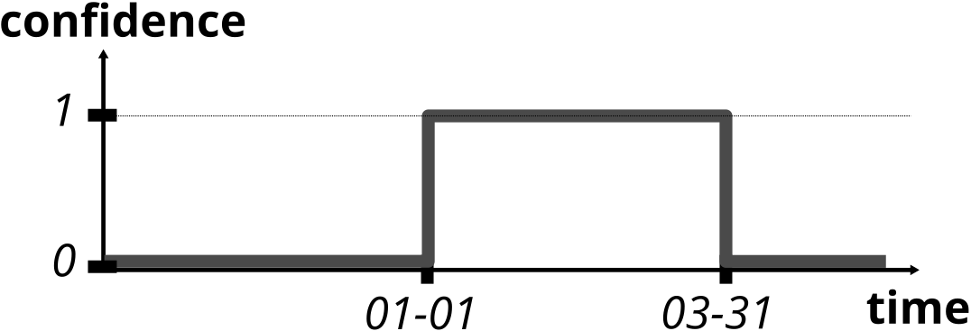
Fuzzy data?
Could interpret as confidence
daterange('2018-01-01', '2018-03-31');

Slide 25
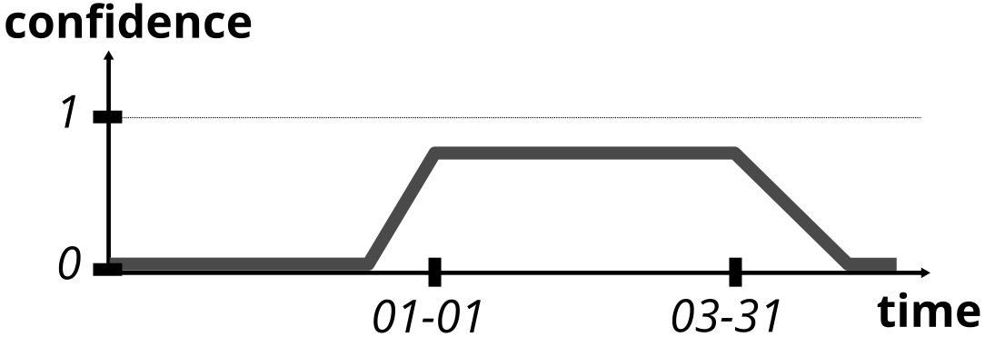
Fuzzy data?
We may need more flexibility: ‘ it can’t be before XX, but I know it was between YY and ZZ for sure’
Extension pgSFTI
Linear confidence
Must be contiguous
Could interpret as confidence
daterange('2018-01-01', '2018-03-31');

Slide 26
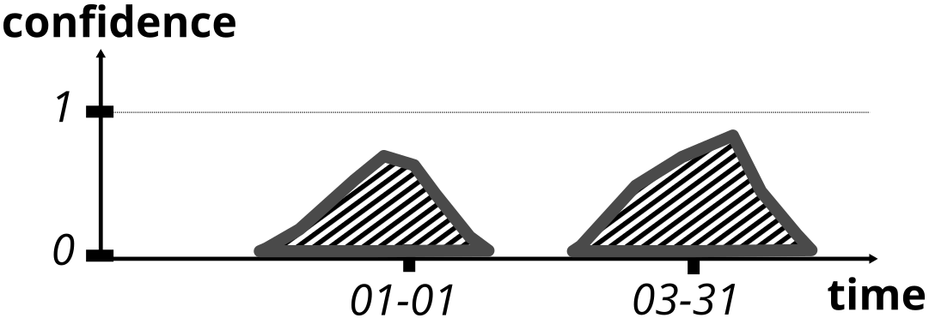
Fuzzy data?
ST_Polygon
Disjoint confidence:
→PostGIS !
Union, distance, intersection
Gist index
Can be overkill

Slide 27
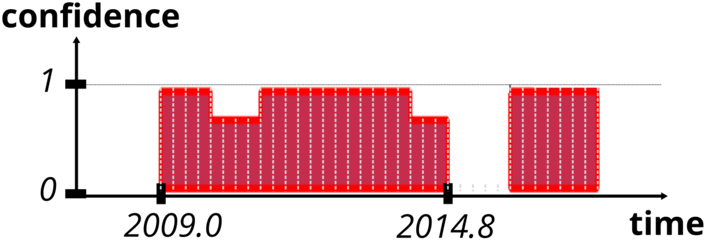
Fuzzy data?
Real life example (viewed in QGIS) Quarters when lobbyist "Tim Bromelkamp“ declared he used to work for legislator "David Minge"
“Sr. LA to Rep. David Minge” | 1.0
“Sr. LA to Rep. Minge” | 0.7

Slide 28
Strategies:
Data is fuzzy “About 10k$”
Data definition is ambiguous “influence” on employees?
Specific to Social Sciences: Explore, be Explainable
Conflicting data sources “J. McCain” VS “McCain, John S.”
Strategy 2: Data definition is ambiguous

Slide 29
Data definition is ambiguous?
2 real lobbying activity reports:
Company 1, 2009 ‘(we lobbied on bill)…HR 1760: Black Carbon Emissions Reduction Act of 2009; Provisions regarding carbon management....’
Company 2, 2010 ‘‘(we lobbied on bill) …HR 1760: Black Carbon Emissions Reduction Act of 2009 (entire bill)’
Which lobbied in support or against? → ambiguous!

Slide 30
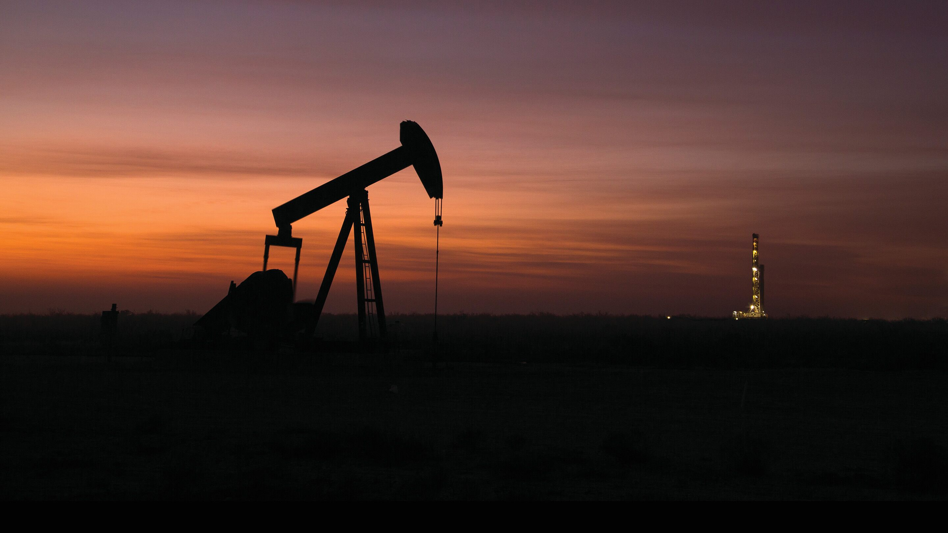
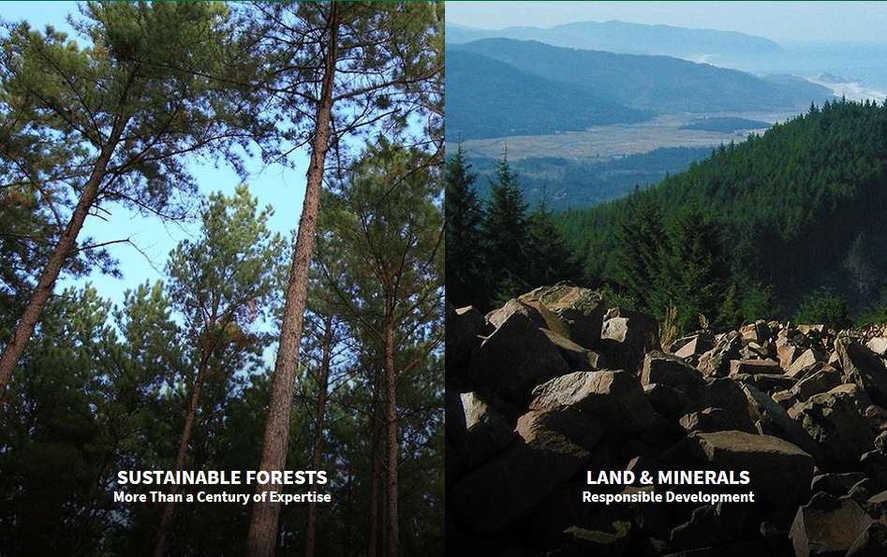
Data definition is ambiguous?
→ Context is also important
Company 1, 2009 : Exxon Inc.
Company 2, 2010: Weyerhaeuser Comp.
Still don’t know for sure !
(company website image)

Slide 31


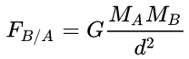
Data definition is ambiguous?
Social Science
Always work
Universal
Local True for specific (hypothesis, context)
Make a choice : lobbied in support
Exxon defends Carbon emission reduction
Physic
Always work
Universal

Slide 32
Data definition is ambiguous?
Allow to make hypotheses
Track, reproduce, explain
Explore different hypothesis
Context is essential
Always trace back to source data
Need domain experts
Many hours of meeting
→Layered architecture

Slide 33
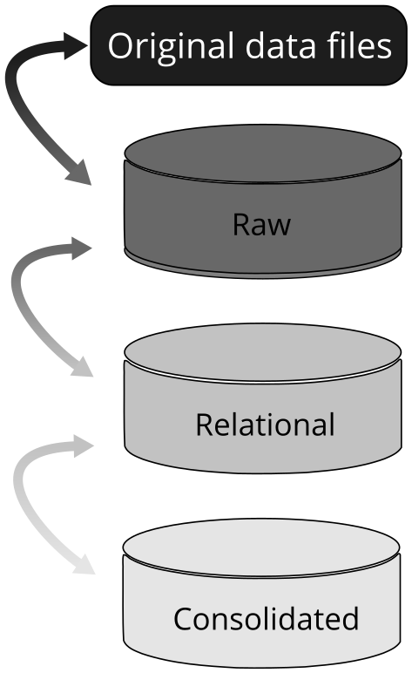
Layered architecture
Layered architecture:
Successive layers
Data more and more transformed
Separate import, normalization and interpretation.
Layers are Connected:
Can always trace to original data
Provides a reproducible pipeline.

Slide 34
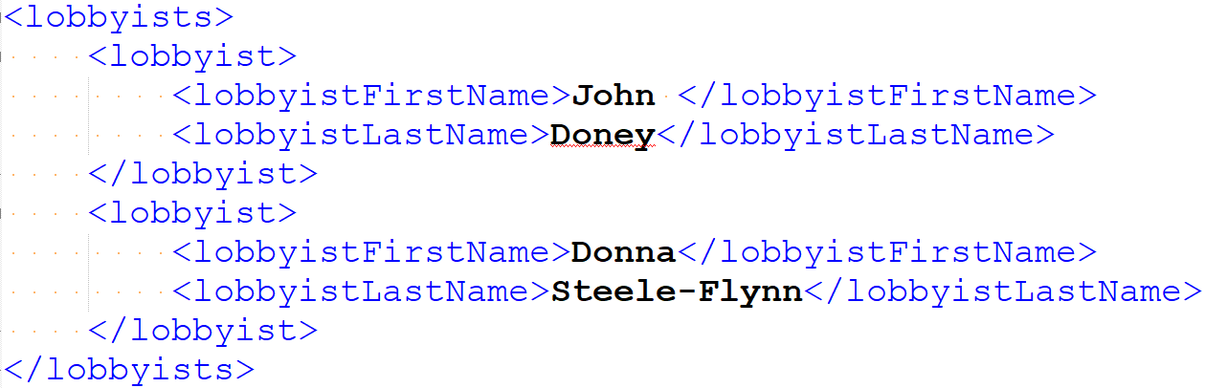
Layered architecture
Xml, csv, json, yaml, html ….
…2010_4thQuarter_XML/300345542.xml

Slide 35
Layered architecture
Import ( )
Foreign Data Wrapper:
File_fdw (+ bash)
Extension Multicorn
COPY …
CREATE FOREIGN TABLE raw___lobby.reports_fxml_fdw (
xml_file_number int8 NULL,
file_content bytea NULL,
filename text NULL)
SERVER filesystem_multicorn_fdw
OPTIONS ...

Slide 36
Layered architecture
Normalized, neutrally cleaned data
Case, trailing white space type casting …
_lobbyist_pk|first_name|last_name |
------------|----------|------------|
38,667,273|Allison |Doney |
37,791,646|John |Doney |
36,429,385|Donna |Flynn |
36,932,677|Donna S. |Flynn |
36,293,145|Emily |Flynn |
38,764,335|Diane |Steed |
34,999,980|Burt |Steele |
37,443,723|Donna |Steele Flynn|
36,083,060|Donna |Steele-Flynn|
36,645,401|James A. |Stem, |

Slide 37

Layered architecture
Choices
entity_{i} = entity_{j} = …
data is interpreted and transformed
|John |Doney |
|Donna |Flynn |
|Donna S.|Flynn |
|Donna |Steele Flynn|
|Donna |Steele-Flynn|
|first_name|last_name |
|----------|------------| |John |Doney |
|Donna |Flynn |
|Donna S. |Flynn |
|Donna |Steele Flynn|
|Donna |Steele-Flynn|
uuid|first_name|last_name | ----|----------|------------|
aec2|John |Doney |
ed3e|Donna |Steele-Flynn|

Slide 38
Layered architecture
Raw:
Original data, from Postgres
FDW
Relational:
Normalize
Consolidated:
Choices
Interpret
Consolidation
|John |Doney |
|Donna |Flynn |
|Donna S.|Flynn |
|Donna |Steele Flynn|
|Donna |Steele-Flynn|
aec2|John |Doney |
ed3e|Donna|Steele-Flynn|

Slide 39
Strategies :
Data is fuzzy “About 10k$”
Data definition is ambiguous “influence” on employees?
Conflicting data sources “J. McCain” VS “McCain, John S.”
Specific to Social Sciences: Explore, be Explainable
Strategy 3: Conflicting data sources

Slide 40
Consolidation?
Consolidation: Decide entity₁ = entity₂
Can be any type of entity
People
Companies
Government agencies
…
|John |Doney |
|Donna |Flynn |
|Donna S. |Flynn |
|Donna |Steele Flynn|
|Donna |Steele-Flynn|
uuid|first_name|last_name | ----|----------|------------|
aec2|John |Doney |
ed3e|Donna |Steele-Flynn|

Slide 41


Consolidation: simple case
Simplest solution: entity → cleaning → strict equality
ex: US. States:
Very convenient
Transitive
Rare
S1|CALIFORNIA
S2|California
S3| california
S1
S3
S1
S3
S2
S2

Slide 42
Consolidation: hard case
L0|John |Doney | L1|Donna |Flynn |
L2|Donna S. |Flynn |
L3|Donna |Steele Flynn|
Compute similarity between entities
Can use many things
Ex: name fuzzy similarity
Extension Pg_trgm
SELECT similarity('Donna Flynn', 'Donna Steele Flynn')-- 0.63
, similarity('Donna Flynn', 'Donna S. Flynn') -- 0.86
0.86
0.15
Donna S.Flynn
Donna Flynn
John Doney
0.65
Donna Steele Flynn
0.63

Slide 43
Consolidation: hard case
Decide what is ‘similar enough’ to be identical.
Manually
Using ML + Python
Find Connected entities PlPython
0.86
0.15
Donna S.Flynn
Donna Flynn
John Doney
0.65
Donna Steele Flynn
0.63
≥0,8
≥0,6
Donna S.Flynn
John Doney
John Doney
OR
Donna Steele Flynn
Donna Steele Flynn

Slide 44
Consolidation: very hard case
Lobbyist_name | employers | colleagues
--------------------|-----------------|------------------------
DONNA, FLYNN | [ERNST & YOUNG] | [Tim URBAN]
STEELE FLYNN, DONNA | [ERNST & YOUNG] | [John DONEY; Tim URBAN]
Also use context
Same colleagues
Same employer
Same topics
…
Index?
Extension smlar to index array

Slide 45
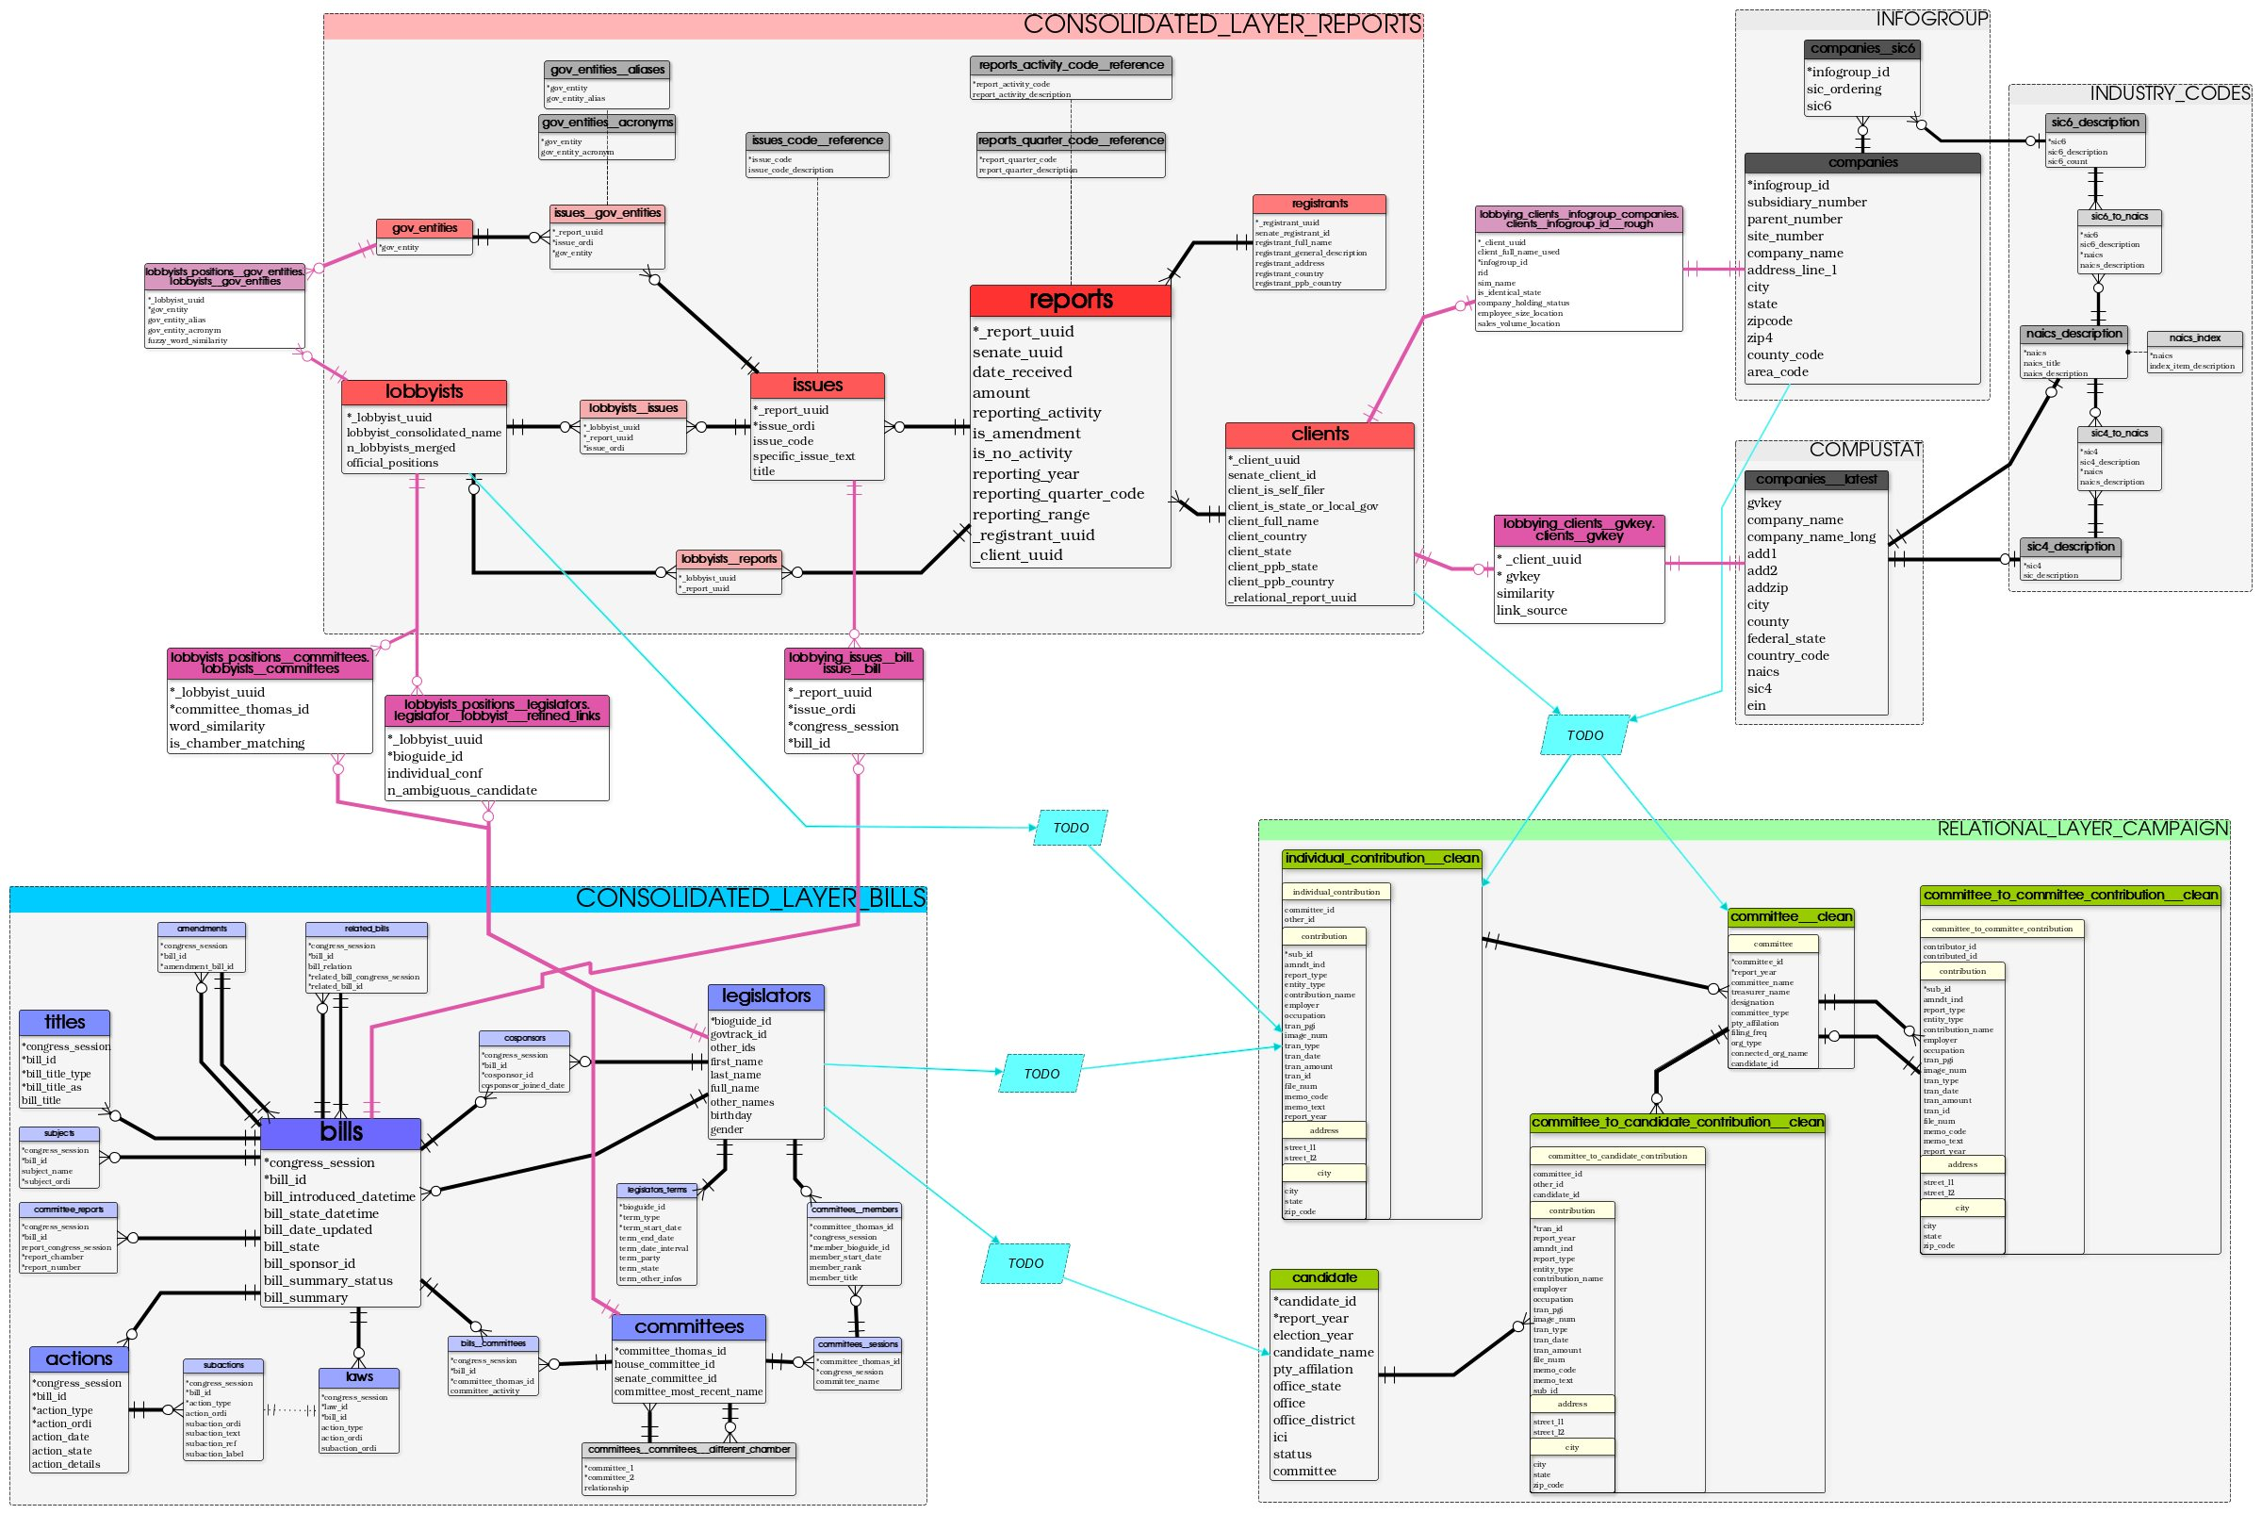
Consolidation: very very hard case
Real life is another topic.

Slide 46
Strategies :
Data is fuzzy “About 10k$”
Data definition is ambiguous “influence” on employees?
Conflicting data sources “J. McCain” VS “McCain, John S.”
Specific to Social Sciences: Explore, be Explainable
Strategy 4: Explore, Explain the data

Slide 47





Explore, Explain the data?
Postgraphile
Automatically build API based on DB schema
Exposes API as GraphQL

Slide 48
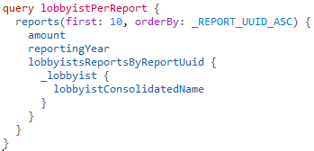
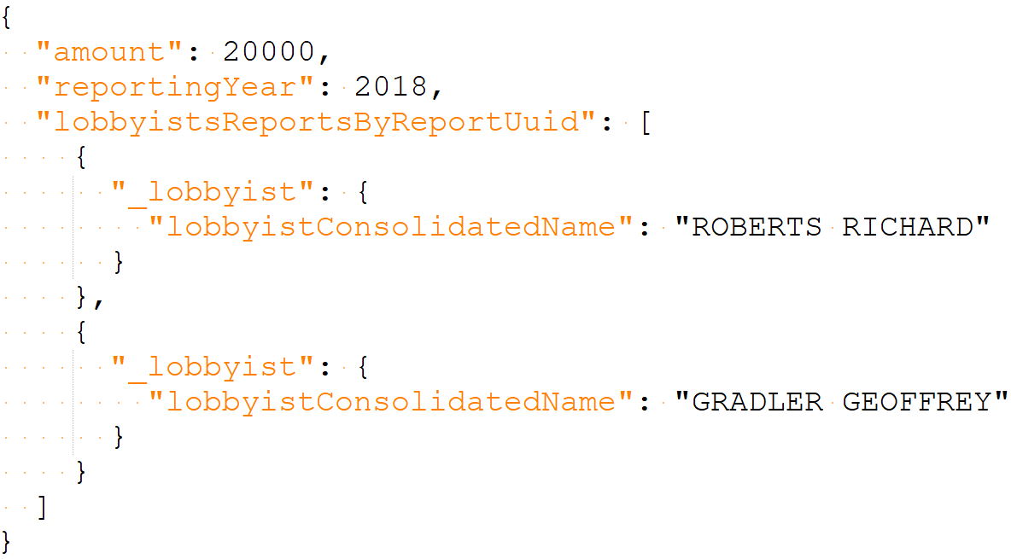
Explore, Explain the data?
SELECT r.amount , r.reporting_year
, lobbyist_consolidated_name
FROM reports as r
JOIN lobbyists__reports USING (_report_uuid)
JOIN lobbyists USING (_lobbyist_uuid)
LIMIT 10;
amount |reporting_year|lobbyist_consolidated_name|
----------|--------------|--------------------------|
$20,000.00| 2,018|ROBERTS RICHARD |
$20,000.00| 2,018|GRADLER GEOFFREY |
Limited
Easier, nested

Slide 49
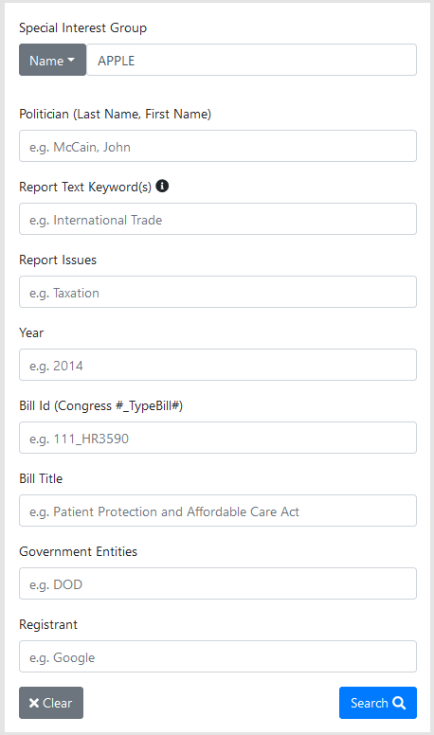
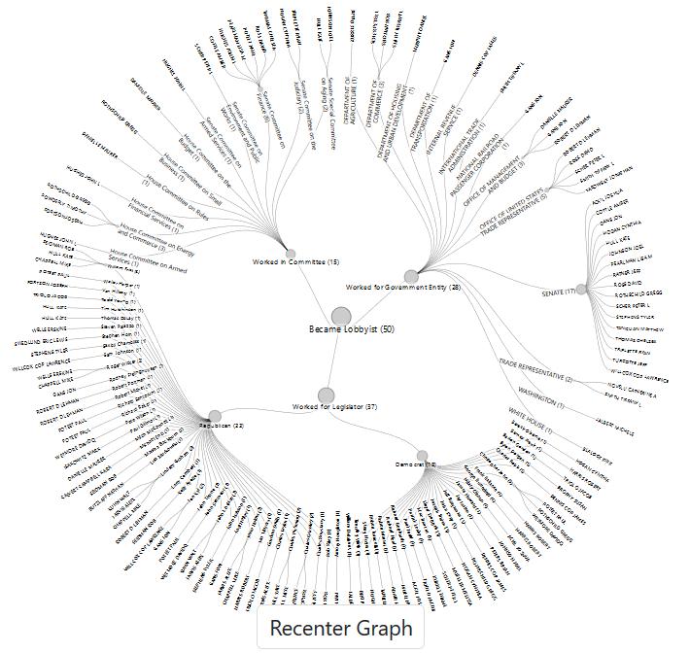
Explore, Explain the data?
Website
filtering
visualization

Slide 50
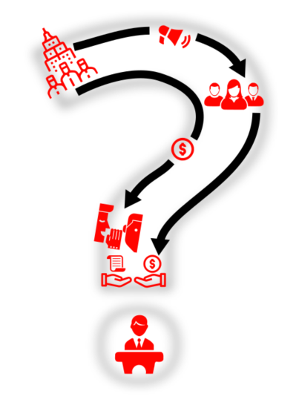
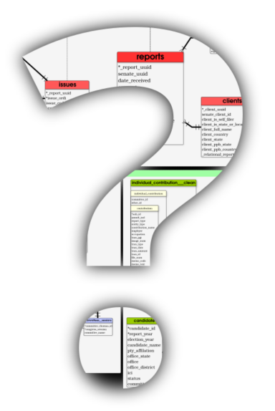
Questions?
Many many thanks to all Open Source projects and people that make that work possible. Postgres + extensions + PostGIS + QGIS + Postgraphile + …

Slide 51
THE END
APPENDIX

Slide 52
Solutions:
Database Modelling

Slide 53
Recipes: Data modelling
Keys
Uuid : not random
Hash of actually unique column combination
Convenient when composite type too big
Composite type
+ domain for constraint
Ex : bill ID
Prob: seem to be confusing for planner (bad indexing?).
Generated identity
= random
Prefer to avoid it.
Ordinality better

Slide 54
Recipes: Data modelling
Light Denormalization
Data is duplicated between layers
Isolation + hides internal when needed (web API)
Json for sparse misc. things
Legislator youtube + twitter + …
When very convenient:
Year + reporting range.
PG12: use of generated columns!
First_name, Last_name, … → full_name
(/!\, cumbersome with inheritance)

Slide 55
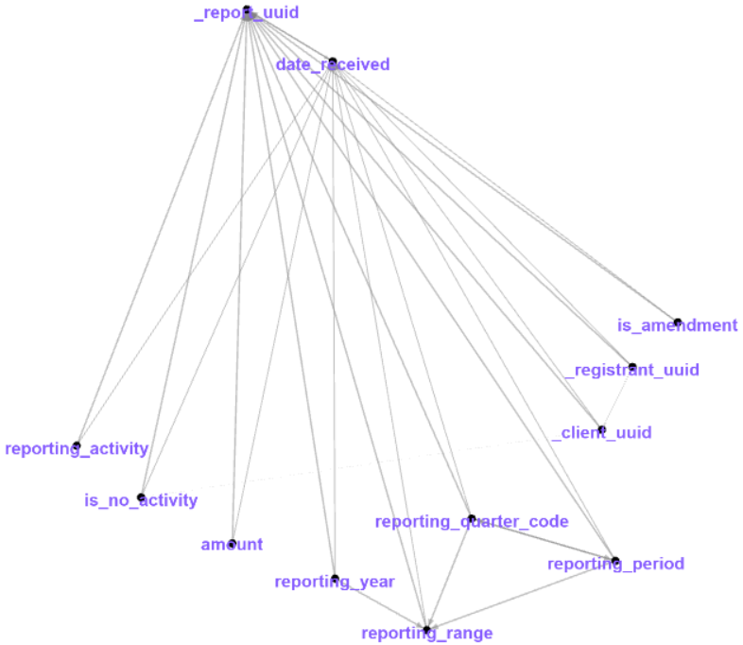
Recipes: Data modelling
Ex of denormalization: Columns dependencies graph.
Date_received = timestamp → almost perfect PK
Some data duplication with report period

Slide 56
CSV issues
Database Modelling

Slide 57
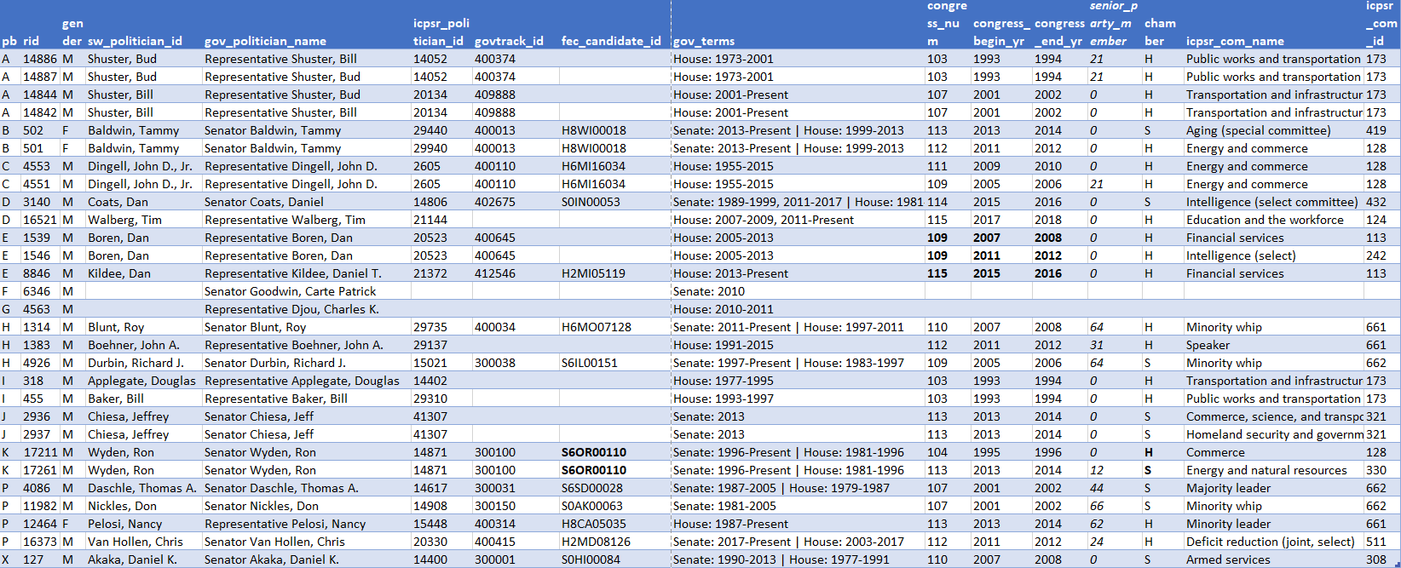
Dataset: errors

Slide 58
Dataset: errors
A : duplicate name : merging went wrong
B: same govtrack_id, different icprs_politician_id
C, P: senior party member?
D, F: gov_terms formatting
E: gov_terms says present, year says 2018
G: NA for committees
H: icpsrs_com_id not coherent with com_name(+…)
I, J: should be same committee name
K: same fec_candidate_id, but campaign for Senate and House
X : control

